Slide 1
Calculating Family Expenses Using Service Now
SlideMake.com

Slide 2

Introduction to Calculating Family Expenses with ServiceNow
ServiceNow is a powerful platform that can be customized to manage and analyze family expenses efficiently.
It provides automation tools that streamline expense tracking and reporting processes.
This presentation will guide you through steps to set up and utilize ServiceNow for family expense calculations.
Notes:
Image source: https://thumbs.dreamstime.com

Slide 3
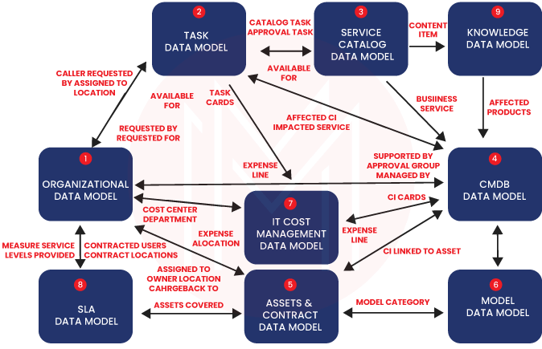
Benefits of Using ServiceNow for Family Expense Management
ServiceNow offers real-time data tracking, enabling accurate expense monitoring.
It improves transparency and accountability within family budget management.
The platform's automation reduces manual effort and minimizes errors in expense calculations.
Notes:
Image source: https://cdn.mindmajix.com

Slide 4

Setting Up Your ServiceNow Environment
Create a dedicated application or module for family expense management within ServiceNow.
Define key data fields such as expense type, amount, date, and payer.
Establish user roles and permissions to control access to sensitive expense information.
Notes:
Image source: https://www.slidemake.com

Slide 5
Creating Expense Data Entry Forms
Design intuitive forms for family members to input their expenses easily.
Use predefined categories to standardize expense types for better analysis.
Implement validation rules to ensure accurate and complete data entries.
Notes:
Image source: https://s3-alpha.figma.com

Slide 6
Automating Expense Data Collection
Utilize ServiceNow workflows to automate reminders for expense submissions.
Set up scheduled jobs to regularly gather and compile expense data.
Integrate with external banking or financial services if needed for automated data import.
Notes:
Image source: https://www.slidemake.com

Slide 7

Analyzing Expenses with Reports and Dashboards
Generate customized reports to visualize spending patterns over time.
Use dashboards to display key financial metrics at a glance.
Filter data to analyze expenses by category, family member, or date range.
Notes:
Image source: https://thumbs.dreamstime.com

Slide 8

Calculating Total and Per Capita Expenses
Use ServiceNow's reporting tools to sum total expenses within a period.
Calculate per capita expenses by dividing total amounts by the number of family members.
Automate these calculations to update dynamically as new data is entered.
Notes:
Image source: https://img.freepik.com

Slide 9
Budget Planning and Forecasting
Set spending limits based on historical expense data.
Use ServiceNow's forecasting features to predict future expenses.
Adjust budgets proactively to ensure financial goals are met.
Notes:
Image source: https://www.slidemake.com

Slide 10

Ensuring Data Security and Privacy
Implement role-based access controls to protect sensitive financial data.
Regularly audit access logs and data changes for security compliance.
Educate family members on data privacy practices within the platform.
Notes:
Image source: https://img.freepik.com

Slide 11

Conclusion and Next Steps
Using ServiceNow streamlines the process of calculating and managing family expenses.
Proper setup and automation enhance accuracy and efficiency.
Start by customizing your ServiceNow environment and gradually incorporate advanced features.
Notes:
Image source: https://thumbs.dreamstime.com

Slide 12
References
ServiceNow Documentation and User Guides (https://docs.servicenow.com)
Financial Management Best Practices (https://www.example.com/financial-best-practices)
Family Budgeting Resources (https://www.familybudgeting.org)

